Slide 1
DTS TRADING PLAN

Slide 2
XT-DTS Plan
ENTRY SIGNAL
1) Build BOX (MINUTE CHART)
2) VOLUME DEMINISHING
3) Buy Queue < SELL QUEUE
* For Homework 1,2,3
4) High Transaction FREQUENCY
5) Breakout 1 BID (Clear ½Q Volume)
Must Completed Full Criteria Before ENTRY.
EXIT SIGNAL
1) Frequency SLOW DOWN
2) Big SELLING PRESSURE
3) BUY QUEUE > Sell Queue
* Any One Standby to EXIT
4) Box STEPDOWN
5) Straight DROP 3 BID
No Matter What Just EXIT

Slide 3
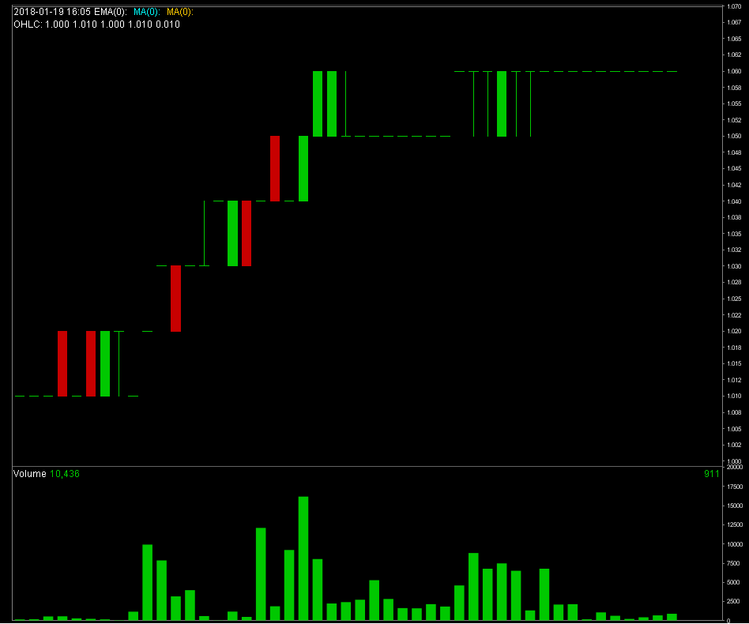

Slide 4
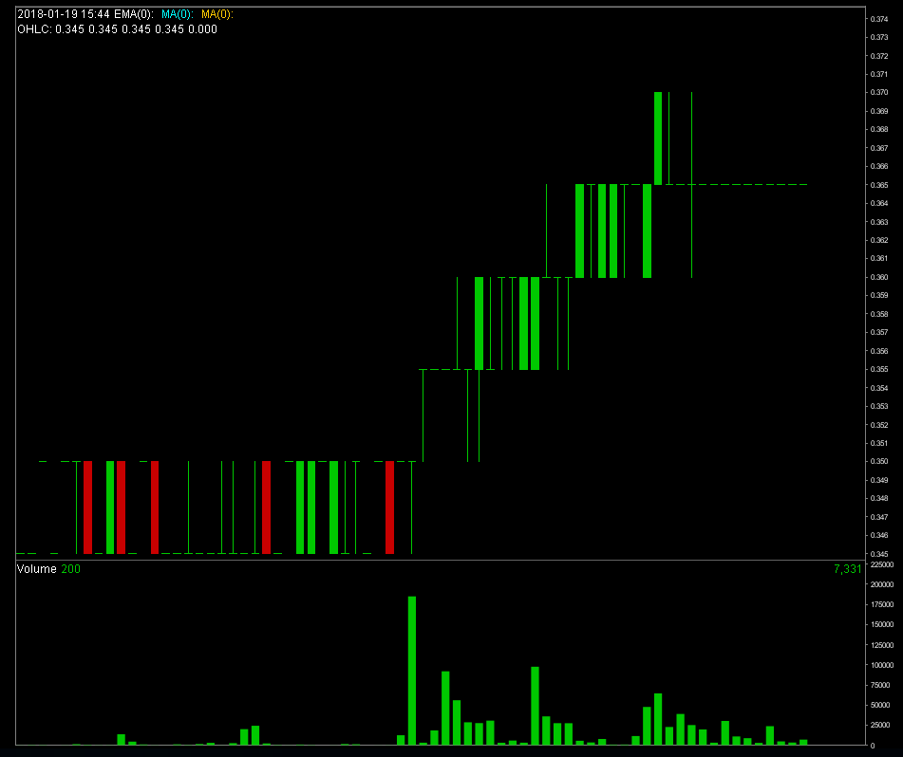

Slide 5
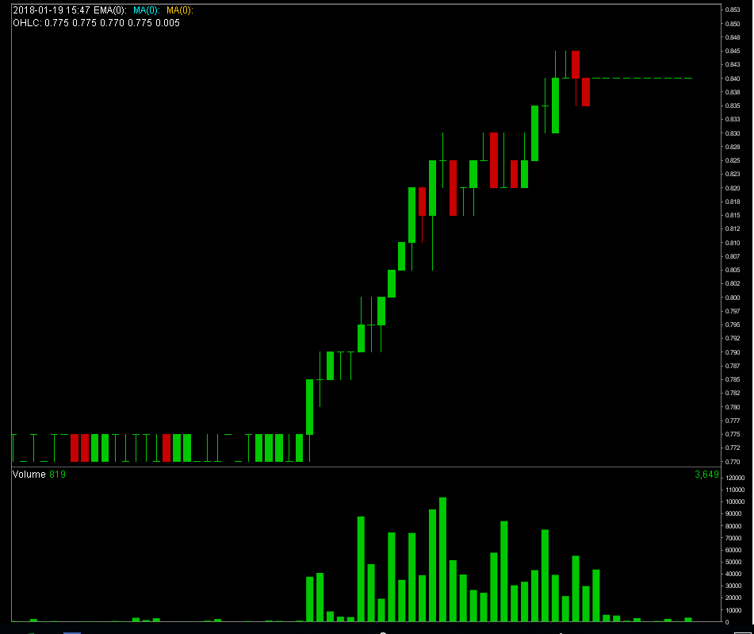

Slide 6
